Slide 1
22CS2403 Database Management System Mini Project Organ Transplantation Network
Tanish P D - ENG22CS0195
Tarun R Bombalekar – ENG22CS0197
Vikram G Rathod – ENG22CS0207
Sachin Naik – ENG22CS0142

Slide 2
Introduction
Objective
The goal of the Organ Transplantation Network project is to develop a robust database management system (DBMS) that facilitates the efficient and secure handling of data related to organ donations and transplantations.
The system aims to streamline the process of matching donors with recipients, manage the logistics of organ transplants, and ensure compliance with medical and ethical standards

Slide 3
Scope of the project
Data Entry and Management: User interfaces for entering, updating, and retrieving data on donors, recipients, organs, hospitals, and medical staff.
Organ Matching: Real-time matching of donors and recipients based on criteria such as blood type, tissue compatibility, and medical urgency.
Communication and Coordination: Automated notifications and messaging systems to facilitate communication between hospitals, transplant coordinators, and medical professionals.
Audit Trails and Logging: Maintain logs of all data changes and access for accountability and compliance purposes.
User Management: Role-based access control to ensure that only authorized users can access or modify sensitive information.

Slide 4
Problem Statement Description of the problem being addressed
Inefficient Matching: Currently, matching suitable donors and recipients can be a slow and cumbersome process. Traditional methods might rely on manual communication and limited data pools, leading to missed opportunities and longer wait times for patients.
Data Management Challenges: Organ donation and recipient data might be scattered across various institutions, making it difficult to get a holistic view of organ availability and patient needs.
Lack of Transparency: The current system might lack transparency for patients waiting for transplants. This can create anxiety and frustration due to the uncertainty of wait times and potential matches.
Limited Data for Improvement: The organ allocation system might lack the data needed to identify trends and areas for improvement. This can make it challenging to optimize the network's efficiency and effectiveness.

Slide 5
Importance of the problem
Life-Saving Procedures: Organ transplants are crucial for patients with end-stage organ failure. Delays can be fatal.
Organ Shortage: Efficient management of scarce organs is essential to save more lives.
Complex Matching Process: Streamlined matching improves accuracy and reduces wait times
Regulatory Compliance: Ensures ethical practices and patient safety through accurate record-keeping.
Data Security and Privacy: Protects sensitive medical data, building trust in the system.
Quality of Care: Real-time data and analytics improve decision-making and transplant success rates.
Transparency and Accountability: Ensures fair and ethical distribution of organs.

Slide 6
System Architecture
The system design for the Online Organ Donation Management System (OODMS) includes a three-tier architecture, ER diagram, schema diagram, normalization up to 3NF, SQL commands, GUI, and system testing. The system design ensures data integrity, consistency, and security while providing an easy-to-use interface for the users.
+---------------+
| Client Tier |
+---------------+
|
|
v
+--------------------+
| Business Tier |
+--------------------+
|
|
v
+-------------------------------------+
| Database Management Tier |
| (MySQL) |
+-------------------------------------+

Slide 7
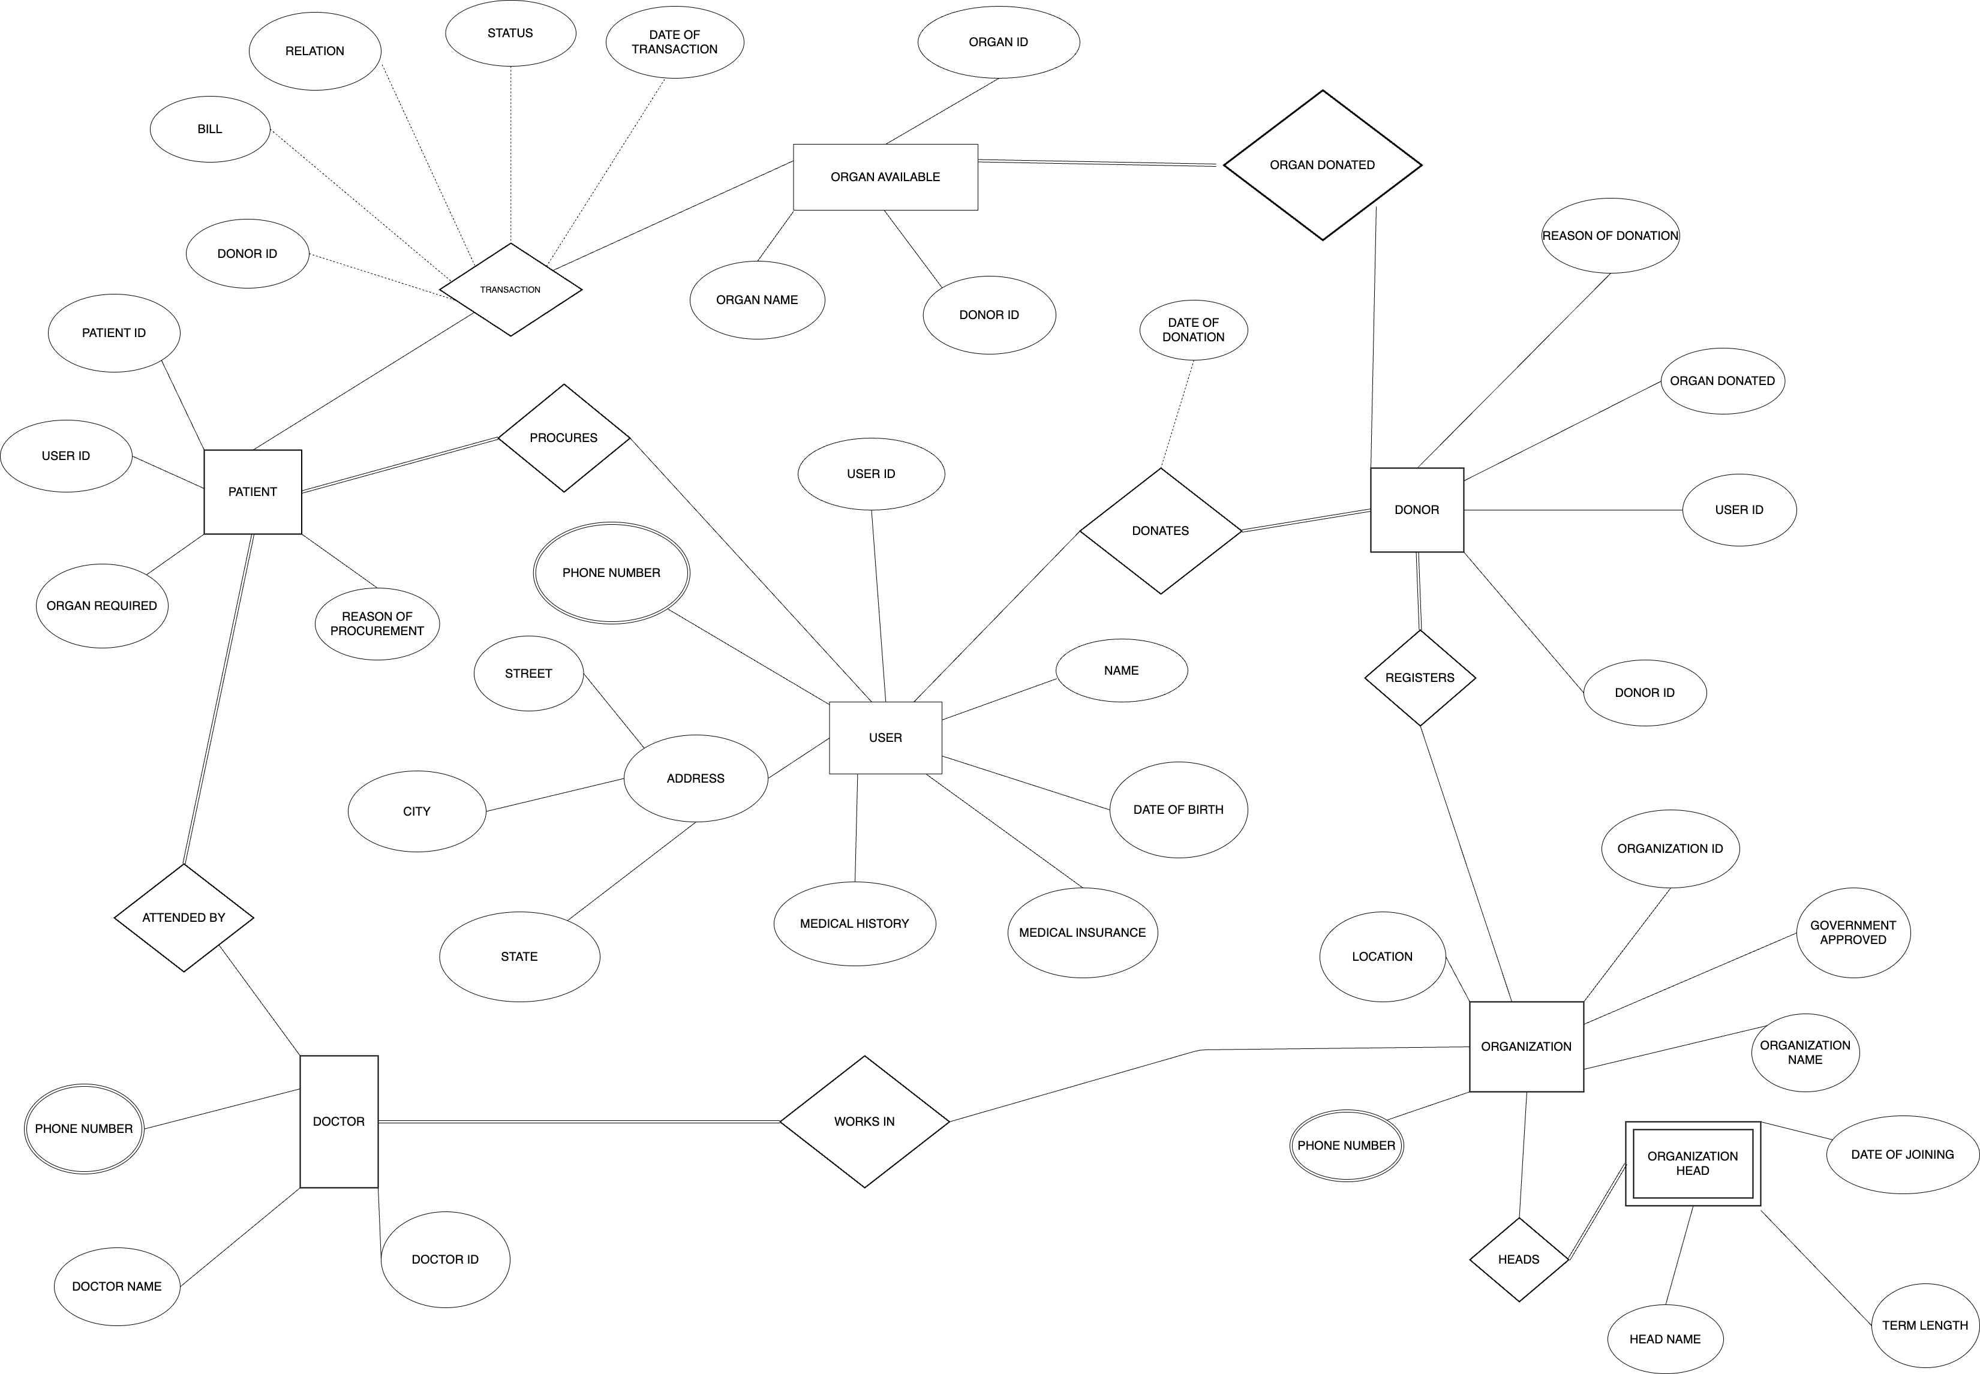
Database Design ER (Entity-Relationship) Diagram

Slide 8
Database schema
User
Patient
Donor
Organ available
Organization
Doctor
Organization head
User_id | Name | Date_of_birth | Phone_number | Medical_insurance | Medical_history | Address
Patient_id | Organ_required | Reason_of_procurement | User_id
Organ_id | Organ_donated | Reason_of_donation | User_id
Organ_id | Organ_name | Donor_id
Organization_id | Organization_name | location | Government_approved | Phone_number
Doctor_id | Doctor_name | Phone _number
Head_name | Date_of_joining | Term_length

Slide 9
Tables and relationships
Relationship Sets:
1. Donates – The act of donation of an organ from a donor
1. Date – Date of donation
2. Procures - The act of procuring an organ by the patient
3. Transaction
1. Date of transaction
2. Status – whether the surgery was successful or not
4. Organ Donated -The organ donated by an donor, which is then stored in Organ_available _table.
5. Attended By -The transplantation performed by doctor – procuring an organ from a donor and transplanting it to the patient by surgery.
6. Registers - Donor is registered in which organization
7. Works in – The organization where the doctor works.
8. Headed By – The organization is headed by which person

Slide 10
Implementation
Technologies and tools used
MYSQL
HTML
CSS
Python
Flask
Visual Studio Code

Slide 11
Key features implemented
Donor Registration: Allow individuals to register as organ donors, capturing essential information such as personal details, medical history, and consent preferences.
Donor Matching and Allocation: Implement algorithms for matching donated organs with suitable recipients based on factors like blood type, tissue compatibility, medical urgency, and waiting time.
Recipient Registration and Evaluation: Enable patients in need of organ transplants to register on the platform, providing medical information for evaluation and inclusion in the waiting list.
Waiting List Management: Maintain a centralized waiting list for each type of organ transplant, prioritizing candidates based on medical urgency, waiting time, and other relevant factors.
Organ Procurement Management: Facilitate the process of organ procurement by coordinating with hospitals, transplant centers, and organ procurement organizations (OPOs). Manage logistical details such as transportation and timing to ensure timely retrieval of donated organs.

Slide 12
Key features implemented
Communication and Notification: Provide communication channels for notifying transplant centers, surgeons, and recipients about available organs, matching results, and transplantation schedules.
Medical Record Integration: Integrate with electronic health record (EHR) systems to access relevant medical data for donors and recipients, ensuring comprehensive evaluation and compatibility assessment.
Regulatory Compliance: Ensure compliance with regulations governing organ transplantation, such as the United Network for Organ Sharing (UNOS) policies and guidelines, as well as local and national regulations.
Data Security and Privacy: Implement robust security measures to protect sensitive medical information, ensuring compliance with healthcare data privacy standards like HIPAA (Health Insurance Portability and Accountability Act).
Reporting and Analytics: Generate reports and analytics to track key performance indicators (KPIs), transplantation outcomes, waitlist dynamics, and other metrics for quality improvement and decision-making

Slide 13
Key features implemented
Public Awareness and Education: Include features for public education about organ donation, transplantation procedures, and the importance of donor registration to increase awareness and encourage participation.
Support for Multi-Organ Transplants: Support the coordination of multi-organ transplants (e.g., heart-lung, kidney-pancreas) by managing the complex logistics and matching requirements for such procedures.
Mobile Accessibility: Offer mobile applications or responsive web interfaces to ensure accessibility for donors, recipients, healthcare professionals, and administrators from various devices and locations.
Donor Family Support: Provide resources and support for the families of deceased donors, including counseling services, information about the donation process, and opportunities for remembrance.
Continuous Improvement: Incorporate mechanisms for feedback collection from stakeholders, such as donors, recipients, and healthcare providers, to identify areas for improvement and refine system functionality over time.

Slide 14
Normalization
Satisfies normalization up to 2NF (Second Normal Form)
The login table is in 1NF since it has a primary key (username) and all columns contain atomic values.
The User table is in 1NF since it has a primary key (User_ID) and all columns contain atomic values. It is also in 2NF since it does not have any partial dependencies.
The Patient table is in 1NF since it has a primary key (Patient_ID, organ_req) and all columns contain atomic values. It is also in 2NF since it does not have any partial dependencies.
The Donor table is in 1NF since it has a primary key (Donor_ID, organ_donated) and all columns contain atomic values. It is also in 2NF since it does not have any partial dependencies.
The Organ_available table is in 1NF since it has a primary key (Organ_ID) and all columns contain atomic values. It is also in 2NF since it does not have any partial dependencies.

Slide 15
Normalization
The Organization table is in 1NF since it has a primary key (Organization_ID) and all columns contain atomic values. It is also in 2NF since it does not have any partial dependencies.
The Doctor table is in 1NF since it has a primary key (Doctor_ID) and all columns contain atomic values. It is also in 2NF since it does not have any partial dependencies.
The Organization_head table is in 1NF since it has a primary key (Organization_ID, Employee_ID) and all columns contain atomic values. It is also in 2NF since it does not have any partial dependencies.
The Transaction table is in 1NF since it has a primary key (Patient_ID, Organ_ID) and all columns contain atomic values. It is also in 2NF since it does not have any partial dependencies.
The Organization_phone_no, Doctor_phone_no, and user_phone_no tables are in 1NF since they have a primary key (Organization_ID, Doctor_ID, user_ID respectively) and all columns contain atomic values. They are also in 2NF since they do not have any partial dependencies.

Slide 16
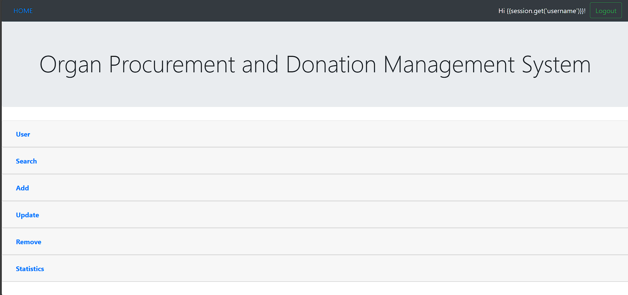
User Interface
Main Page – GUI

Slide 17
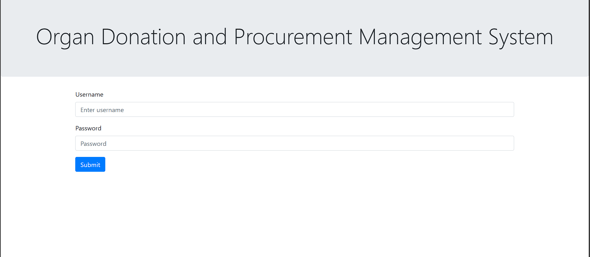
Login Page

Slide 18
Challenges Faced
Difficulties encountered during the project
Regulatory Compliance: Meeting regulatory requirements, such as those set by UNOS and other regulatory bodies, can be challenging. Ensuring that the system complies with all legal and ethical standards related to organ donation and transplantation is crucial but can involve navigating intricate regulatory frameworks.
Logistical Challenges: Coordinating organ procurement and transplantation logistics involves managing a myriad of logistical details, such as transportation, timing, and communication between multiple stakeholders (hospitals, transplant centers, OPOs). Ensuring timely and efficient coordination can be challenging, especially in emergency situations.
Stakeholder Engagement: Engaging and coordinating with various stakeholders, including healthcare professionals, transplant recipients, donor families, and regulatory agencies, is essential for the success of the project. Building consensus, managing expectations, and addressing concerns from diverse stakeholders require effective communication and collaboration strategies.
Ethical Considerations: Addressing ethical considerations related to organ donation and transplantation, such as informed consent, equity in access to transplantation, and allocation fairness, requires careful deliberation and adherence to ethical guidelines. Balancing competing ethical principles while designing and implementing the system can be challenging.

Slide 19
How these challenges were addressed
Regulatory Compliance: Establish a dedicated team or work closely with legal and regulatory experts to ensure that the system complies with all relevant regulations and standards. Conduct thorough research on applicable laws and guidelines, and incorporate compliance checks and validations into the system's design and development process.
Logistical Challenges: Establish clear communication channels and protocols for coordinating organ procurement and transplantation logistics. Implement dedicated software modules or tools for managing logistical details, such as transportation scheduling, inventory tracking, and real-time communication between stakeholders.
Stakeholder Engagement: Foster open communication and collaboration with stakeholders through regular meetings, workshops, and feedback sessions. Solicit input and feedback from stakeholders throughout the project lifecycle and prioritize their needs and concerns in system design and implementation.
Ethical Considerations: Form an ethics committee or engage ethicists and healthcare professionals to address ethical considerations and dilemmas related to organ donation and transplantation. Develop clear guidelines and protocols for ethical decision-making and ensure transparency and accountability in the allocation process.

Slide 20


